Slide 1

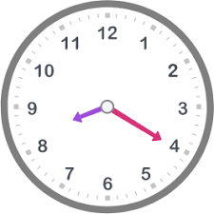
TIME AND STRESS MANAGEMENT

Slide 2
TIME MANAGEMENT
1.What is time management?
Time management is the process of planning and exercising conscious control of time spent on specific activities, especially to increase effectiveness, efficiency, and productivity.
2.What is the need for time management?
Using time effectively gives the person “choice” on spending or managing activities at their own time and expediency.
3.Benefits and advantages of time management?
There is clarity.
It gives control of your life.
Reduces stress.
Prevents procrastination.
You get more done in less time.

Slide 3
4.How do you manage time?
Figure out how you're currently spending your time
Create a daily schedule—and stick with it.
Group similar tasks together.
Assign time limits to tasks.
Learn to say no.
5.Various techniques
Set goals correctly
Set goals that are achievable and measurable. Use the SMART method when setting goals. In essence, make sure the goals you set are Specific, Measurable, Attainable, Relevant, and Timely.
Follow the 4 D’s are: Do, Delay, Delegate, and Delete.
Follow the 4 P’s are: Productivity, Positivity, Priortization, Planning
The Pareto Principle is the idea that 80% of consequences come from 20% of causes. Applied to productivity, it means that 80% of results can be achieved by doing 20% of tasks. If productivity is the aim of time management, then these tasks should be prioritized higher.

Slide 4

STRESS MANAGEMENT
1.What is stress management?
Stress management is a wide spectrum of techniques and psychotherapies aimed at controlling a person's level of stress, especially chronic stress, usually for the purpose of and for the motive of improving everyday functioning.
2.What is the need for stress management?
Stress is found to be a component to heart disease, diabetes, ulcers and various other health diseases. Stress can cause emotional eating and a lack of motivation or energy to exercise and maintain healthy behaviors. Managing your stress can mean a longer, happier and healthier life.

Slide 5
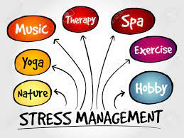
3.What are the benefits of Stress Management?
Sleep better.
Control your weight.
Improve your heart health .
Improves your performance in terms of work.
Be in a better mood.
Get along better with family and friends.
4.How do you manage stress?
Express your emotions and yourself .
Make time for hobbies and interests.
Set limits appropriately and say no to requests that would create excessive stress in your life.
Accept that there are events that you cannot control.

Slide 6

RECAP:
Manage your time . It reduces workload on yourself and hence helps reduce stress.
Stress and time management are inter dependent.
Managing both of them helps you do better in life.
This improves your health quality, hence you can live a better life and enjoy your life with your loved ones.
THANK YOU ☺

